Slide 1
Examining the variation between healthy and cancer patient plasma via PANORAMA
Pres. by Nareg Ohannesian
6-10-2021

Slide 2
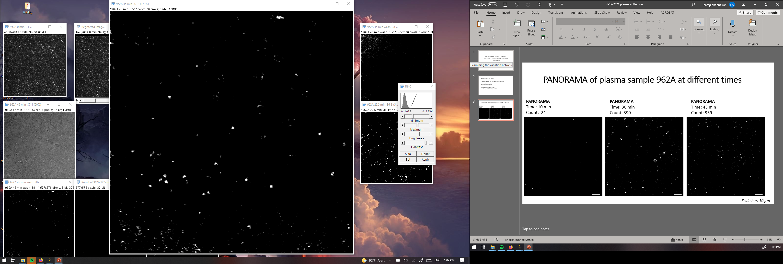
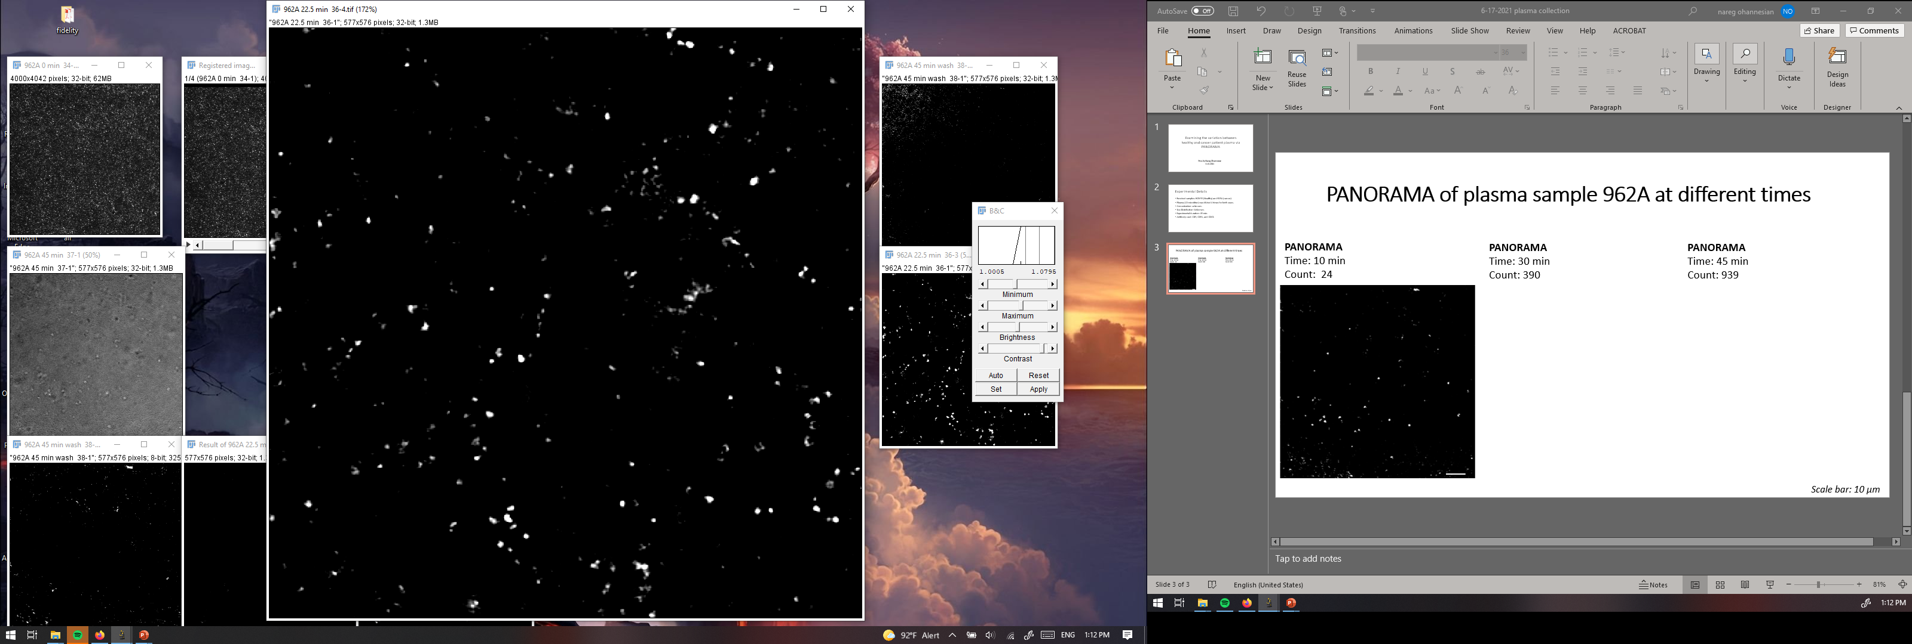
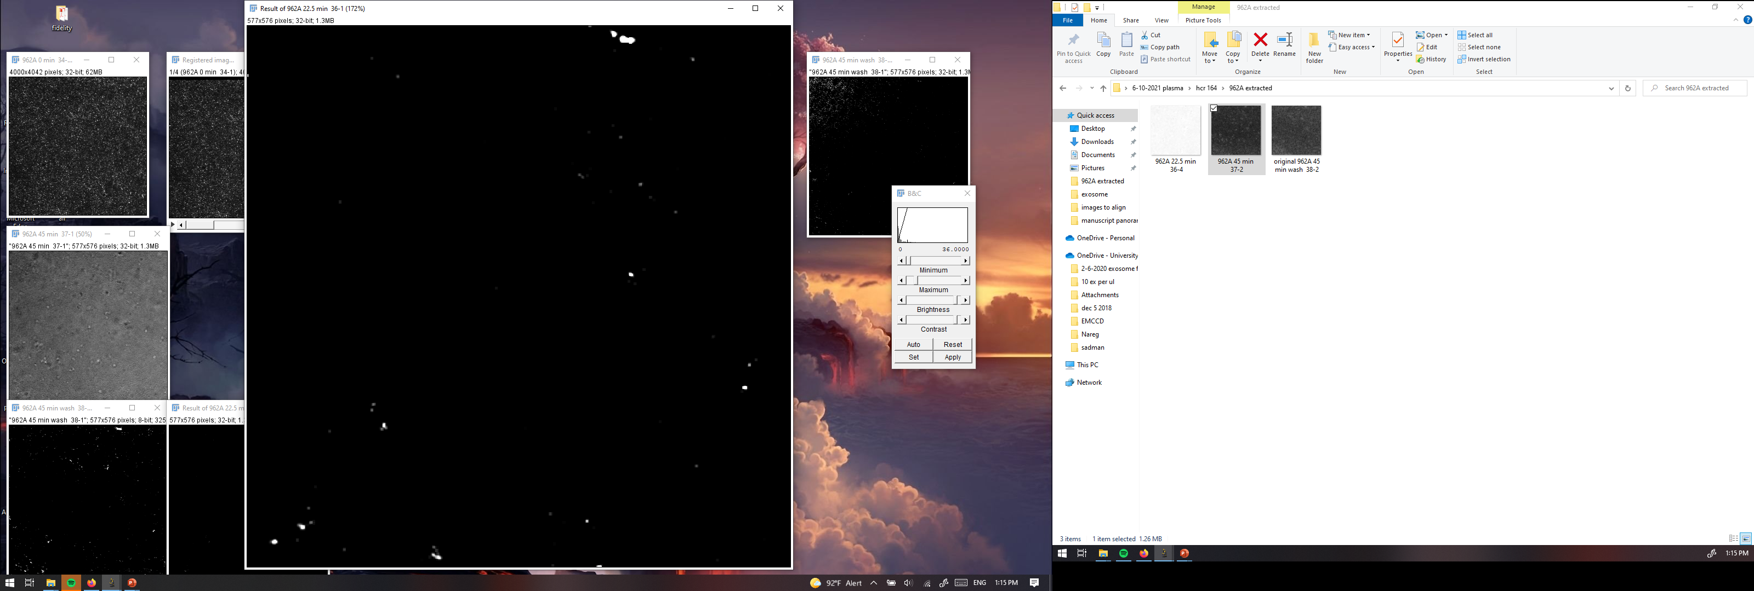
PANORAMA of plasma sample 962A at different times
PANORAMA (1.17 ± 0.08)
Time: 60 min
Count: 460
PANORAMA (1.12 ± 0.035)
Time: 60 min wash
Count: 72
PANORAMA
Time: 30 min
Count: 208
16 % of detected particles captured after wash
Scale bar: 10 µm

Slide 3
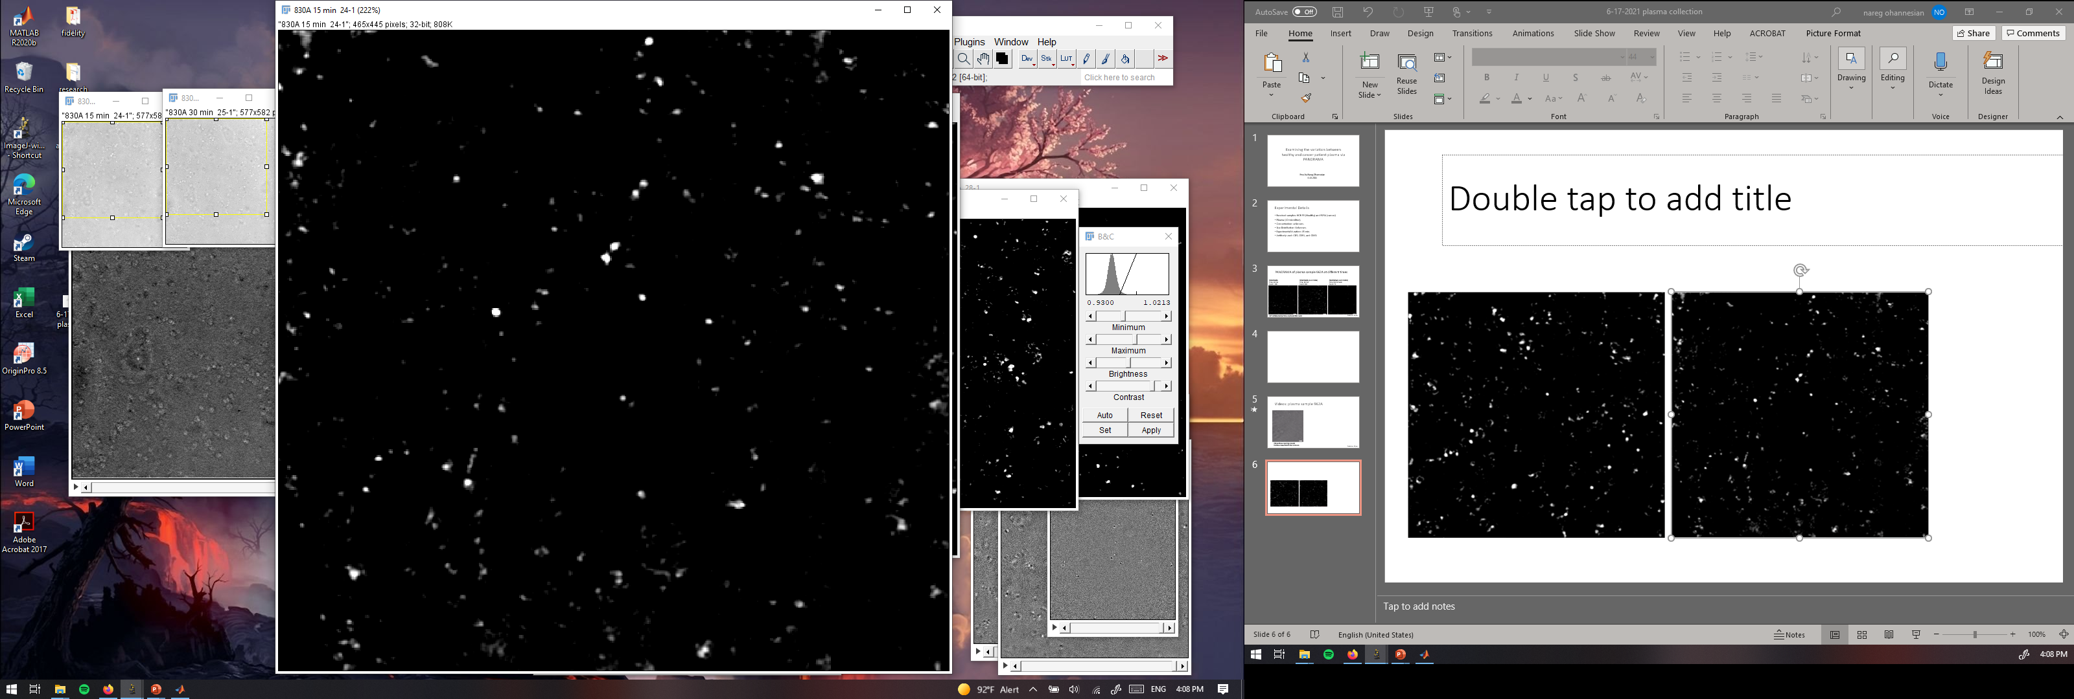
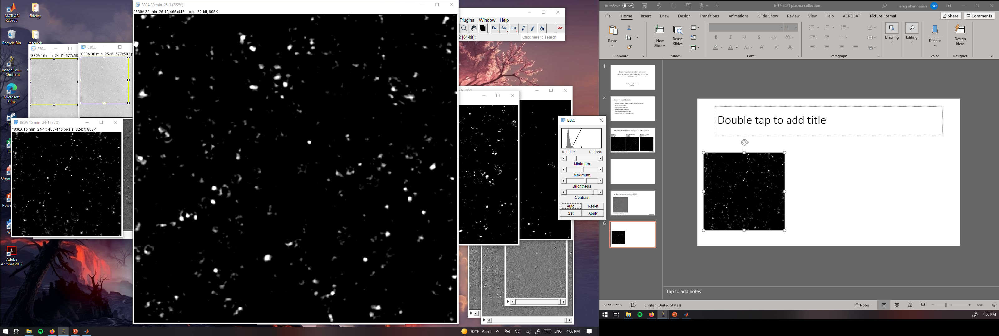
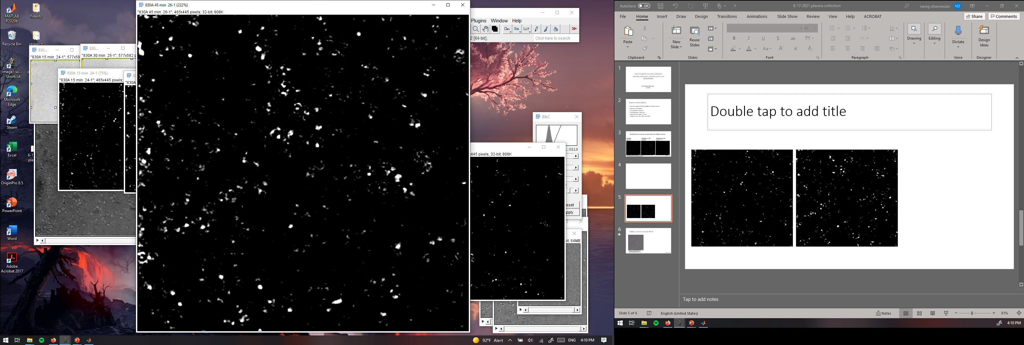
PANORAMA of plasma sample 830A at different times
PANORAMA
Time: 15 min
Count: 160
PANORAMA
Time: 30 min
Count: 530
PANORAMA
Time: 60 min
Count: 767

Slide 4
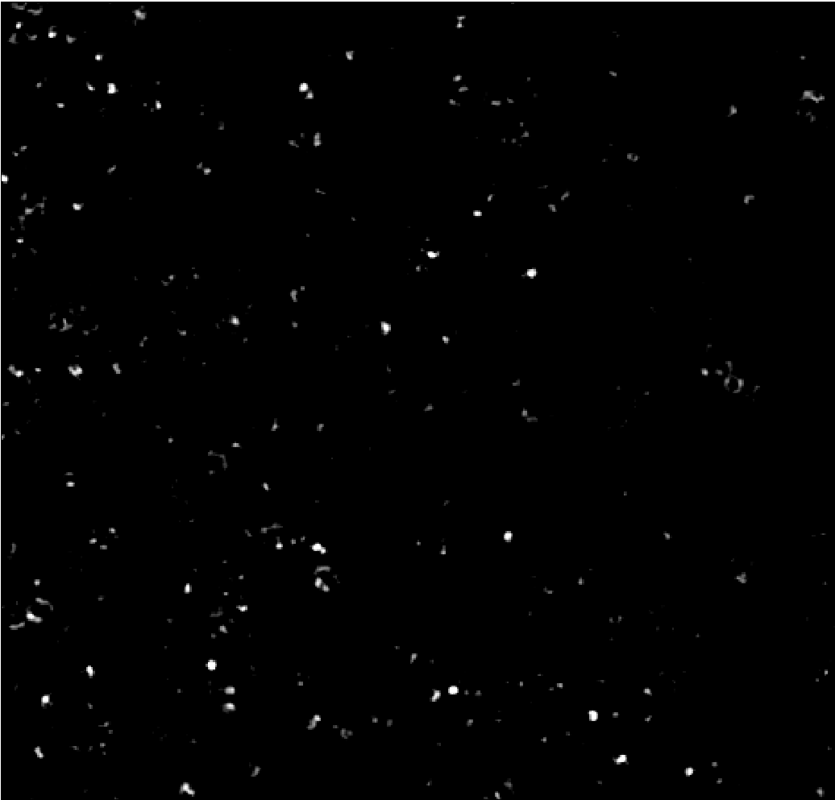
PANORAMA of plasma sample 830A at different times
PANORAMA (1.11 ± 0.045)
Time: 60 min
Count: 767
PANORAMA (1.10 ± 0.035)
Time: 60 min wash
Count: 283
36 % of detected particles captured after wash

Slide 5
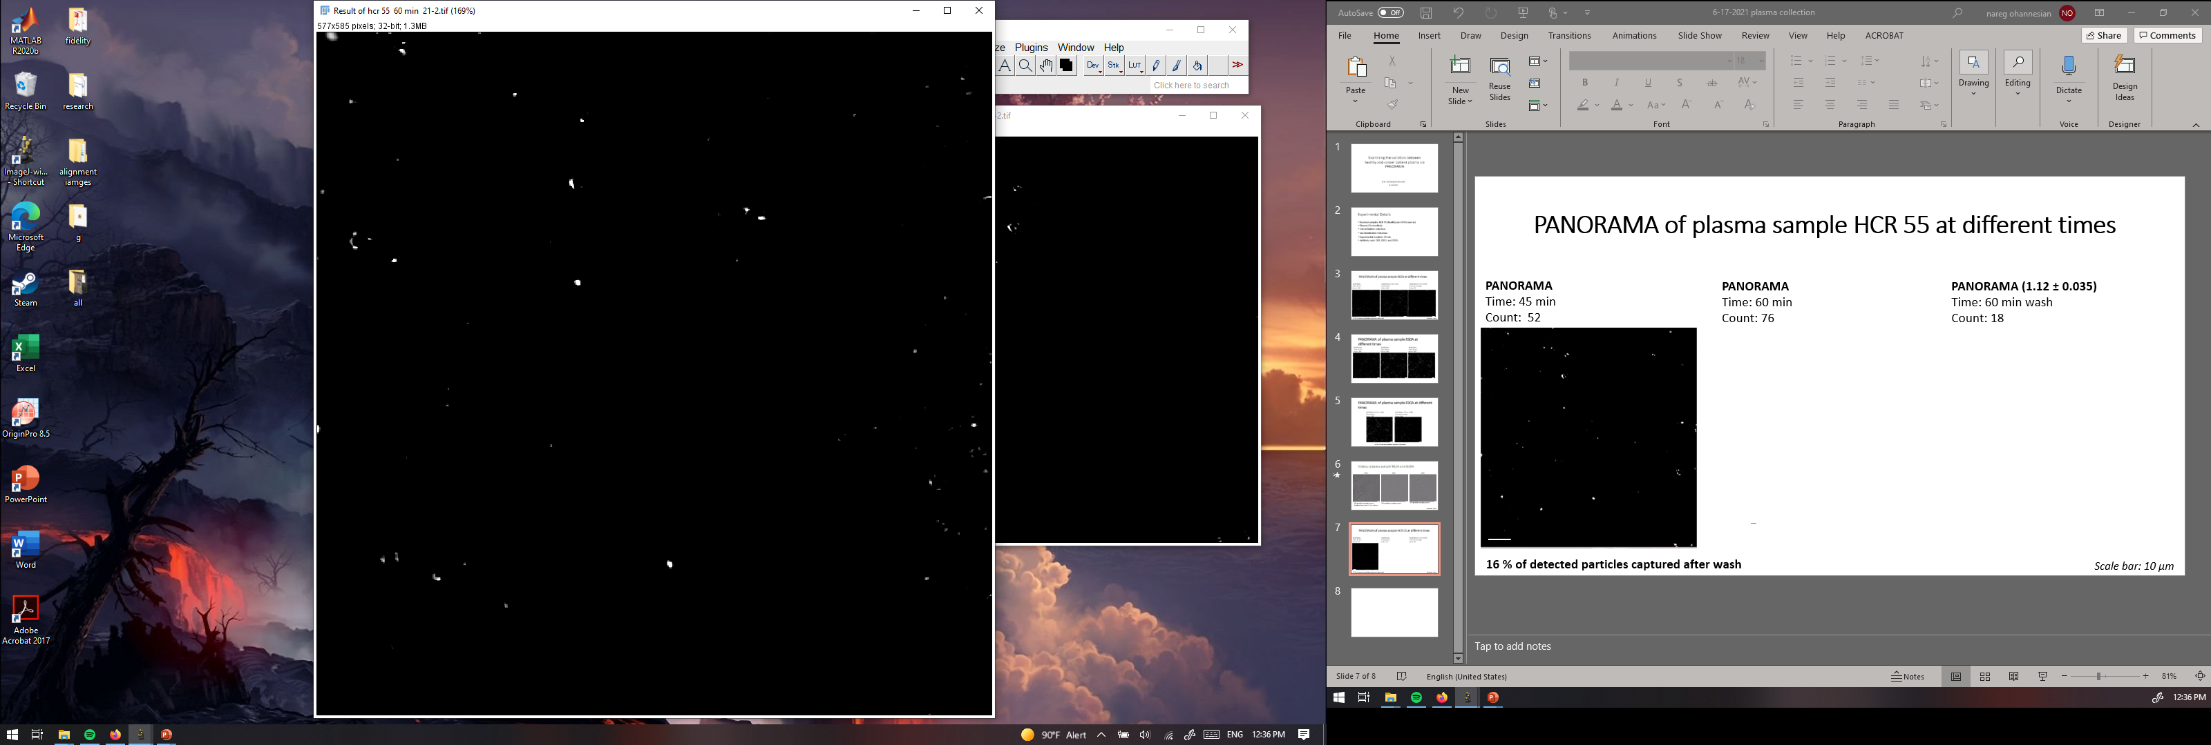
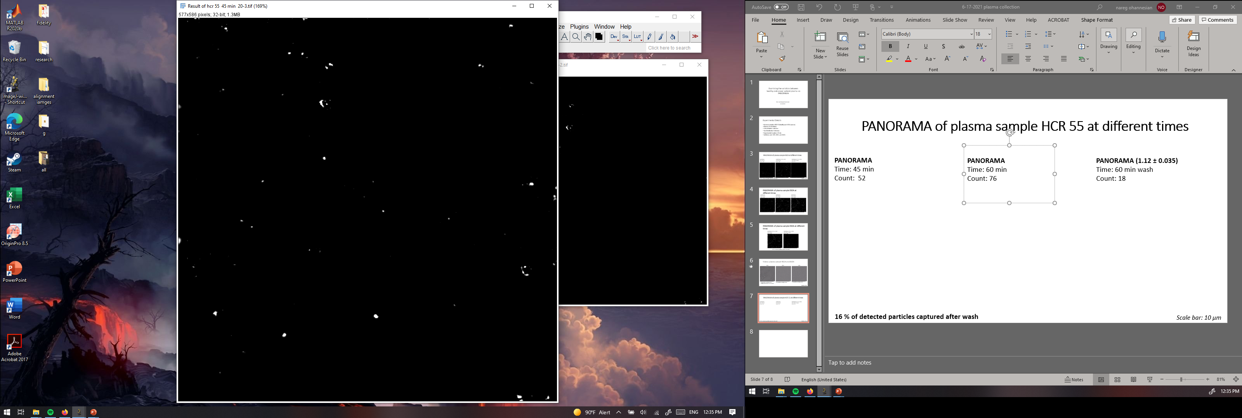
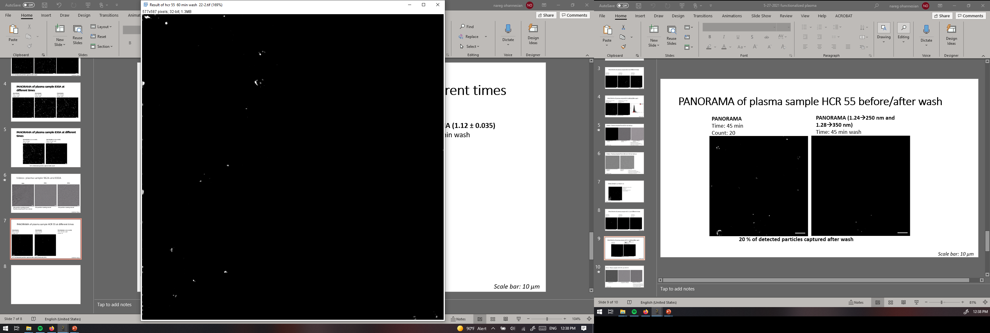
PANORAMA of plasma sample HCR 55 at different times
PANORAMA
Time: 60 min
Count: 76
PANORAMA (1.13 ± 0.035)
Time: 60 min wash
Count: 18
PANORAMA
Time: 45 min
Count: 52
23 % of detected particles captured after wash (Previously 16%)
Scale bar: 10 µm

Slide 6
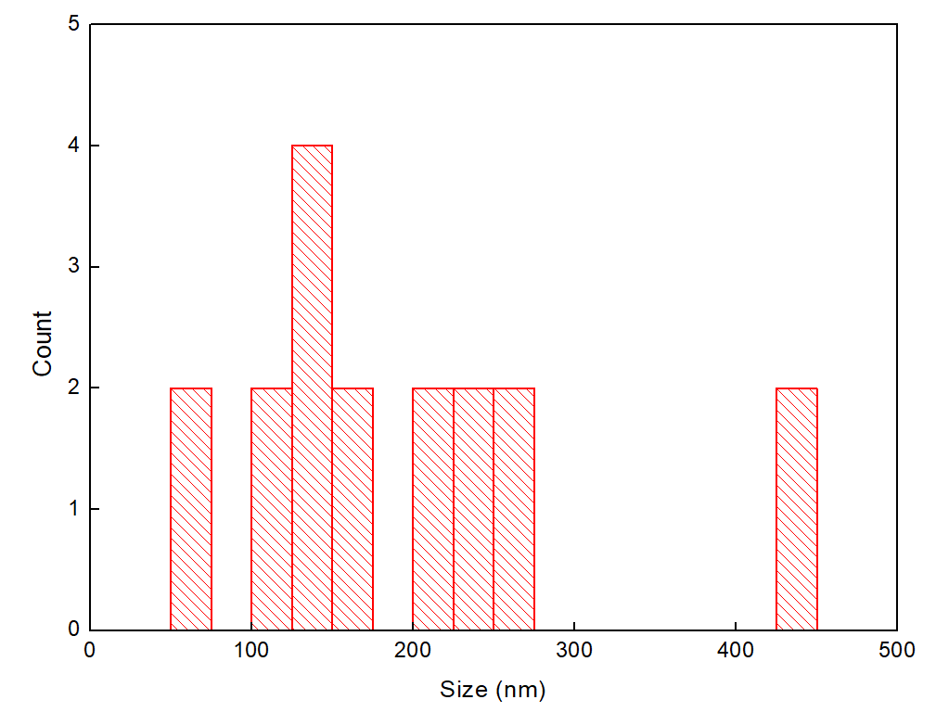
Size information of Captured particles from HCR 55

Slide 7

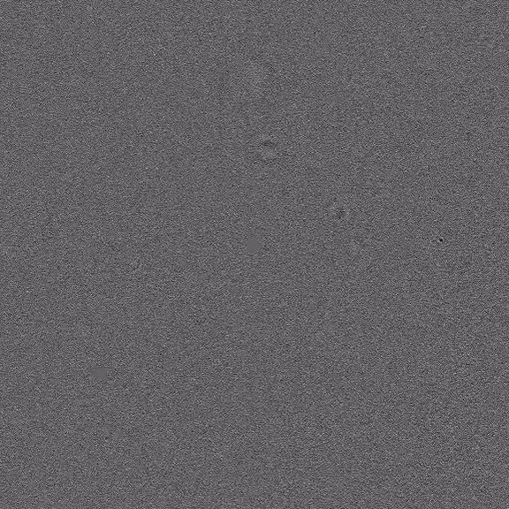
Videos: plasma samples
HCR 55
HCR 153
35 particles roaming around
Particles show from 0.5 to 1 micron
21 particles roaming around
Scale bar: 10 µm

Slide 8
Particle sizing from 830A
IR | Derived size (nm) | Actual size (nm)
1.98 | 930 | 975
1.48 | 720 | 780
1.52 | 740 | 780
2.04 | 936 | 975

